Slide 1
Predicting which participants have Alzheimer disease
A project by Lauren Dunn

Slide 2
Agenda
Introduction to Alzheimer Disease
Why machine learning?
Introduction to Dataset
My approach
Models
Logistic Regression
Support Vector Machine
Random Forest
Limitations of models
Future direction

Slide 3
Agenda
Introduction to Alzheimer Disease
Why machine learning?
Introduction to Dataset
My approach
Models
Logistic Regression
Support Vector Machine
Random Forest
Limitations of models
Future direction

Slide 4

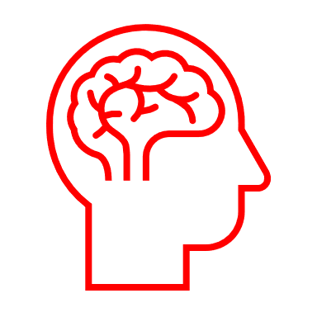

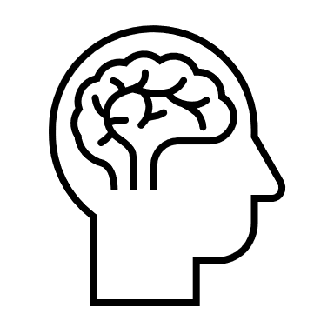


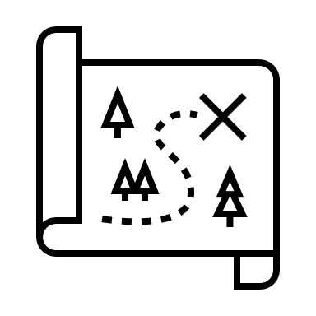




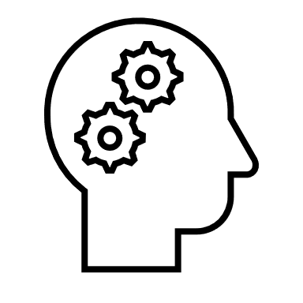
What is Alzheimer disease?
1. Alzheimer disease is neurodegenerative disorder and comes under the disease dementia
2. Common Symptoms
1+1 = 2
60-70%
Notes:
Alzheimer disease comes under the disorder dementia and makes up to 60-70% of dementia cases.
Alzheimer disease is a neurodegenerative disorder
The most common symptom is memory loss which worsens over time
Other symptoms include; misplacing items, lack of judgement, mood swings, social withdrawal, repetitive questions, inability to complete complex task, loss of speech, incontinence and weight loss
In later stages people suffering from Alzheimer disease need full time care

Slide 5


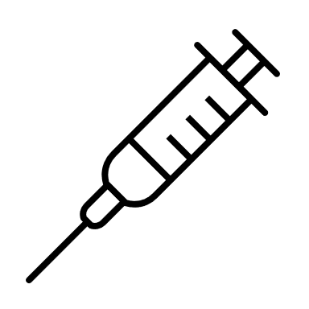





Alzheimer disease prevalence
850,000 people in the UK have dementia
This is thought to increase to 1.5 million by 2040
Costing the currently economy £26.3 billion
Currently no cure only medication
to treat symptoms of the disease
Notes:
Around 850,000 people in the UK have dementia which represents 1 in 14 people in the uk (2019)
This is thought to increase to 1.5 million by 2040
Alzheimer disease is a form of dementia and makes up 60-70% of these cases
The estimated cost of dementia is £26.3 billion
Unforntunately AD has no cure only medication to treat the symptoms
Therefore finding a cure or detecting AD not only could benefit the economy but also releieve burden to families

Slide 6
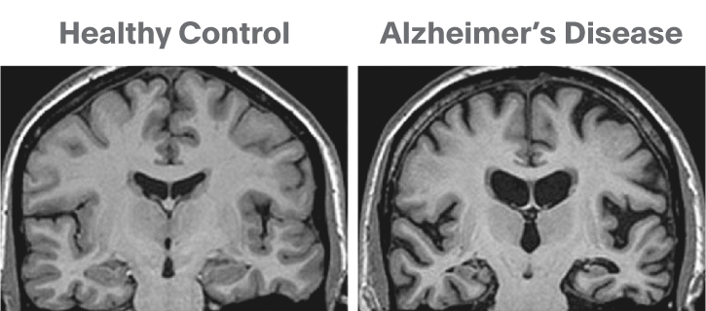
Why machine learning?
Before onset of Alzheimer disease symptoms we can see deposits of toxic proteins accumulating 10-20 years before symptoms arise.
Therefore being able to identify patients at risk of AD is paramount in order for them to start treatment earlier and a live a better life.
Currently AD is diagnosed by clinicians: cognitive assessments, MRI scans, patient history and PET
PET is particularly invasive and expensive
Current treatments focus on slowing the disease down not curing it. Therefore early diagnosis of AD is paramont in order to maximise quality of life for families and sufferers.
Thereby by using machine learning using factors researched ot affect AD; age, education level, socioeconomic status, cognitive assessments, MRI scans could be quick, noninvasive and effective solution to identify patients at risk for AD.

Slide 7
Agenda
Introduction to Alzheimer Disease
Why machine learning?
Introduction to Dataset
My approach
Models
Logistic Regression
Support Vector Machine
Random Forest
Limitations of models
Future direction

Slide 8
Why machine learning?
Alzheimer disease is thought to start between 10-20 years before symptoms arise
Alzheimer disease diagnosed by clinicians using a multiple factors; brain scans, patient history, cognitive assessments.
Machine learning model can aid clinicians and also non-invasive to patient

Slide 9
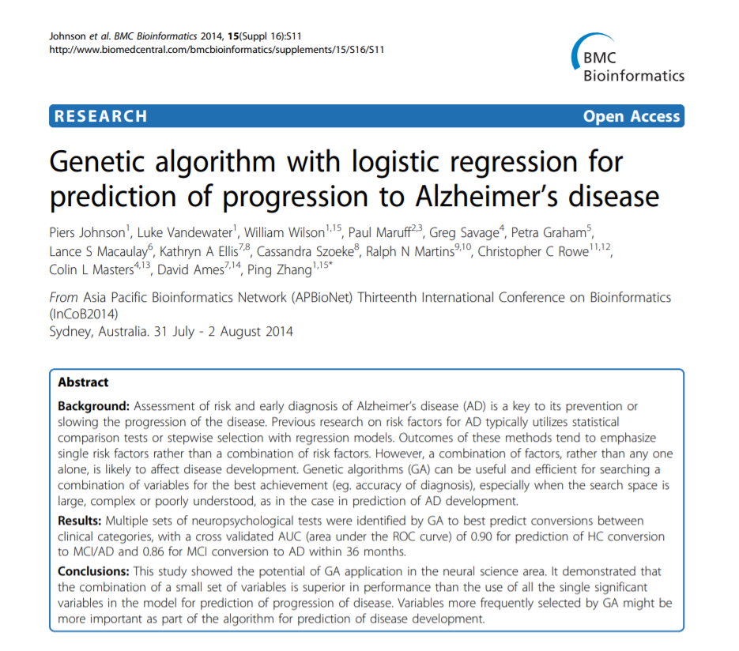
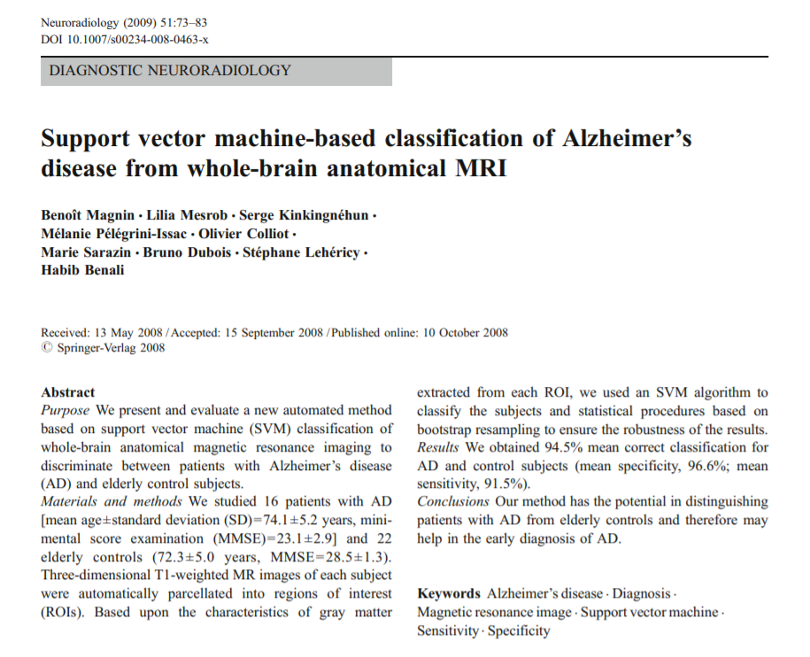
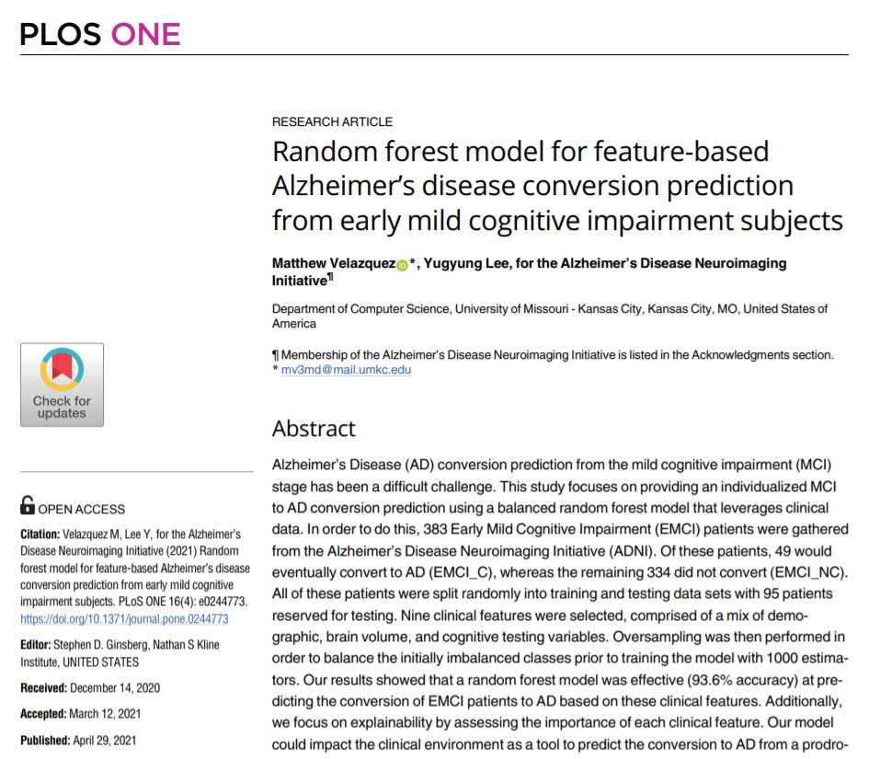
Current research utilizing machine learning algorithms to predict Alzheimer disease
Notes:
These are some of the papers currently in the field which I will compare my results to at the end of this presentation.

Slide 10
Agenda
Introduction to Alzheimer Disease
Why machine learning?
Introduction to Dataset
My approach
Models
Logistic Regression
Support Vector Machine
Random Forest
Limitations of models
Future direction

Slide 11

Dataset
Data information
Data came from OASIS and also on Kaggle
150 people ranging from ages 60-96
Each person was scanned at least twice over a period of more than a year
Demented Patients | Non Demented Patients | Converted Patients
72 | 62 | 14

Slide 12
Problem statement
Build a model that can be used to predict those patients with Alzheimer disease
Models: Logistic Regression, Support Vector Machine and Random Forest

Slide 13
Dataset Demographics

Slide 14
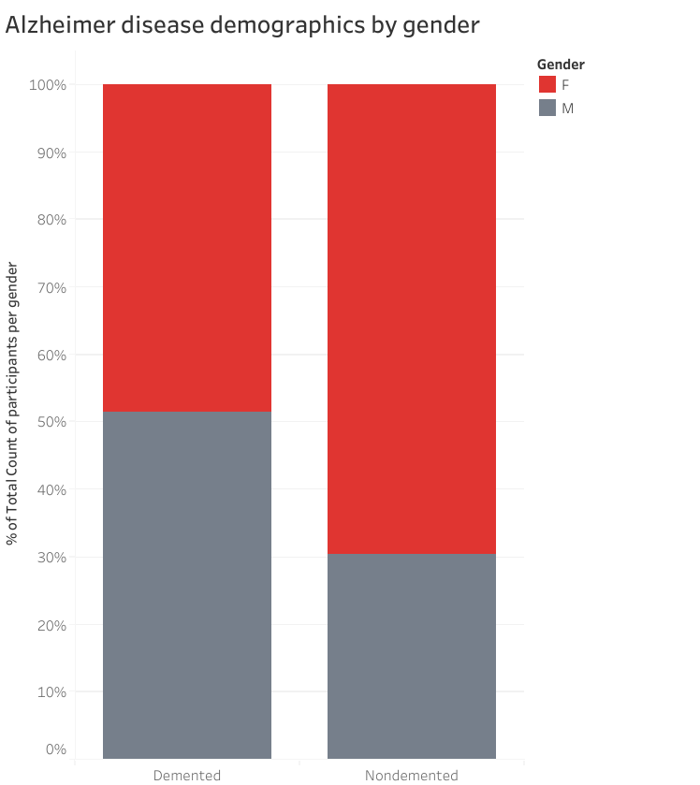
Alzheimer disease vs Gender
Notes:
This dataset indicates that men are more likely to get Alzheimer disease than woman
However looking at longitudinal research this is not the case! Woman are more likely to get Alzheimer disease than men. Potentail limitation to the study. This could be because of the small amount of data to this study. Feeding the model the wrong data!

Slide 15
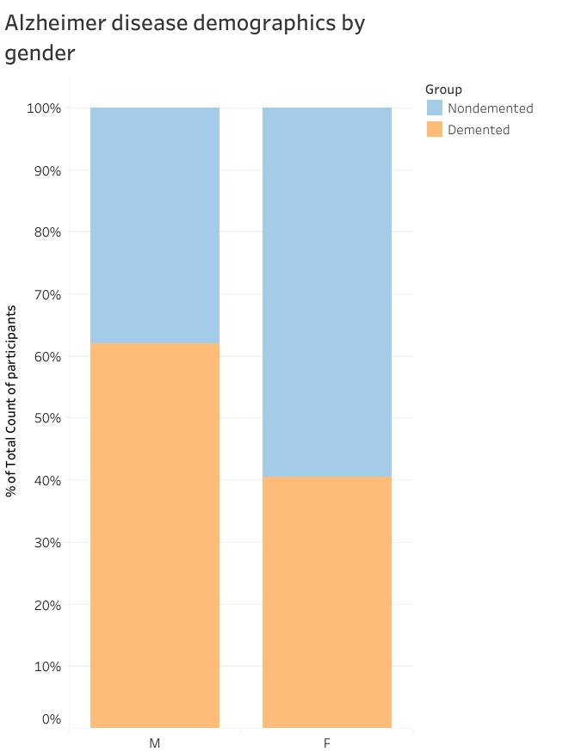
Male participants have a higher number of Alzheimer disease cases

Slide 16
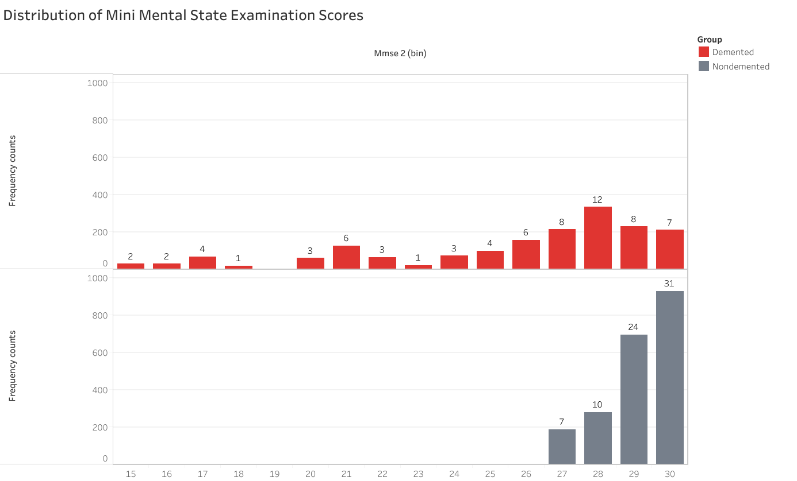
Frequency counts
Mini Mental State Exam Scores
Notes:
Change Frequency counts

Slide 17
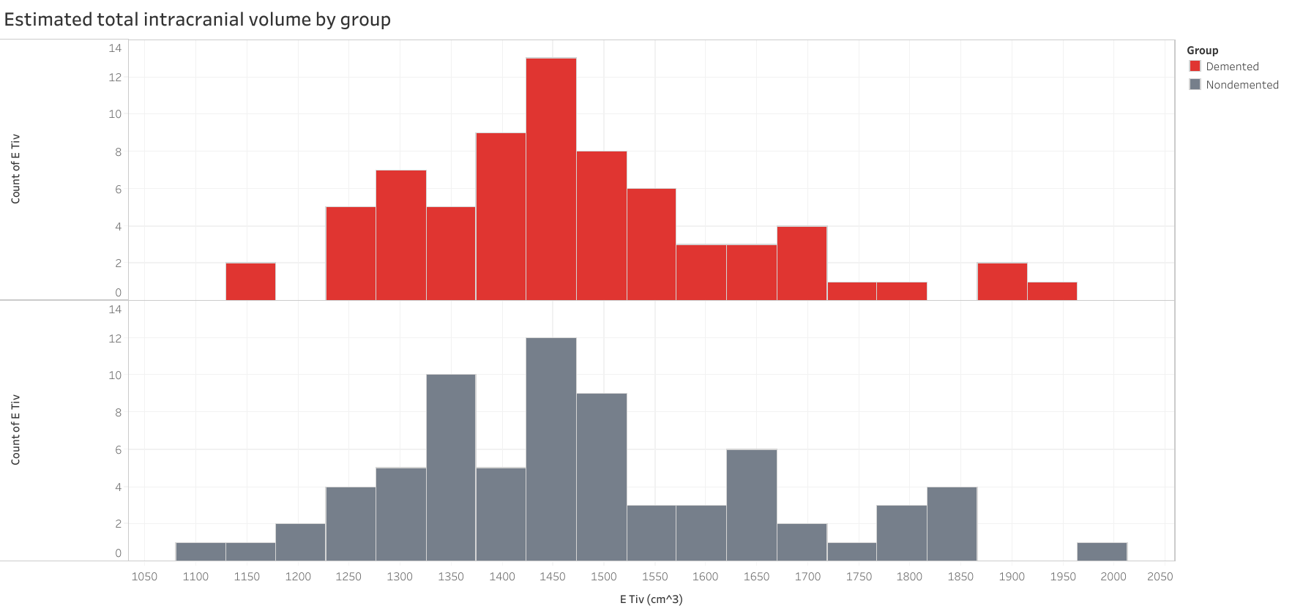
MRI metrics and dementia
Notes:
Keep Etiv the same. Minus nBW! -> do this for the model

Slide 18
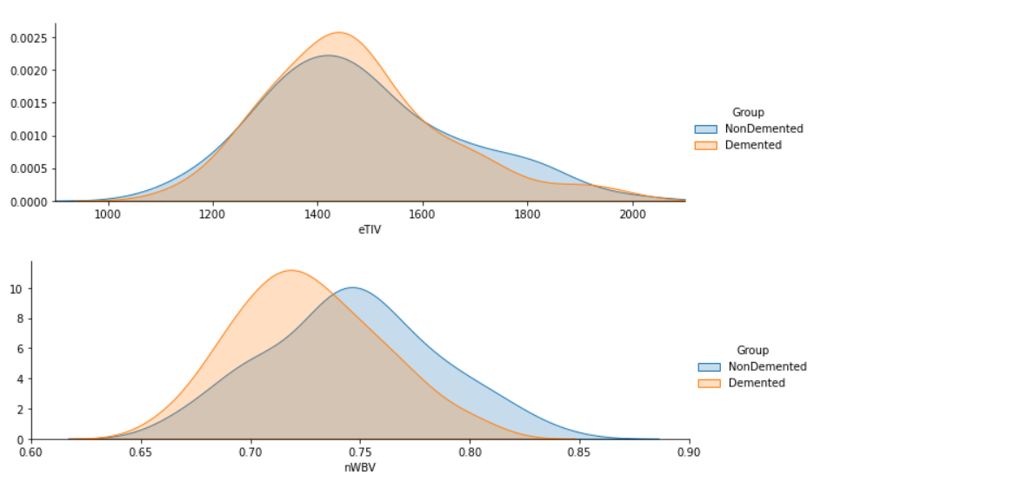
Alzheimer disease patients tend to have a smaller brain volume
eTIV:
estimated intracranial volume
nWBV:
Normalised whole brain volume
Notes:
Keep Etiv the same. Minus nBW! -> do this for the model

Slide 19
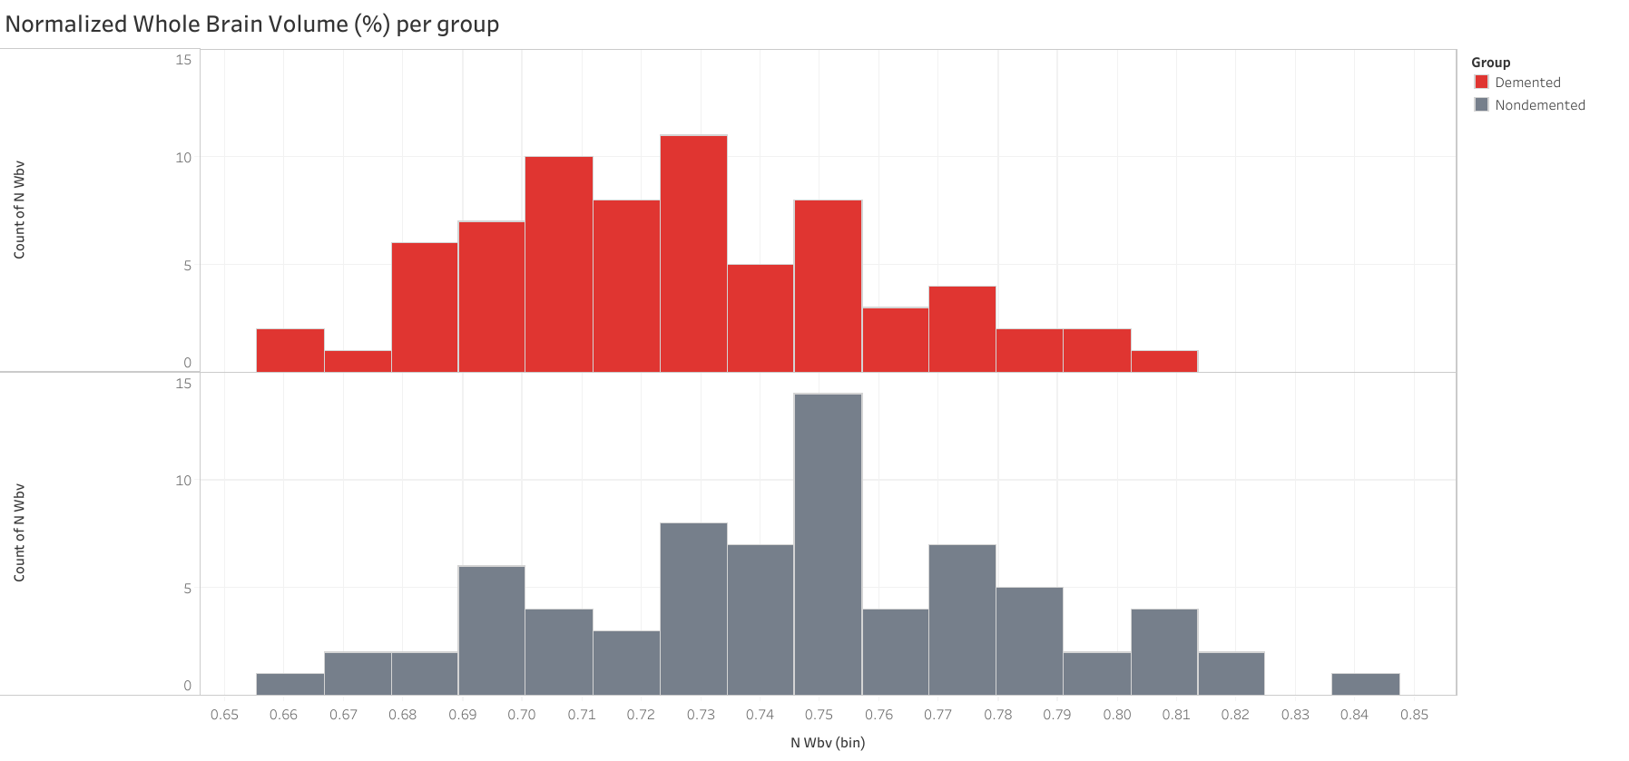
MRI metrics and dementia
Notes:
Keep Etiv the same. Minus nBW! -> do this for the model

Slide 20
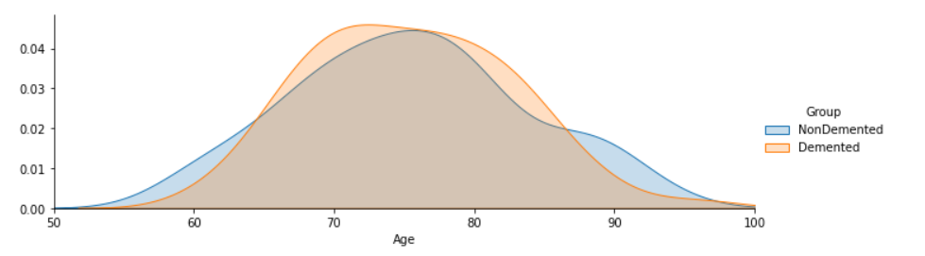
Alzheimer disease patients are more concentrated around 65-85 mark

Slide 21
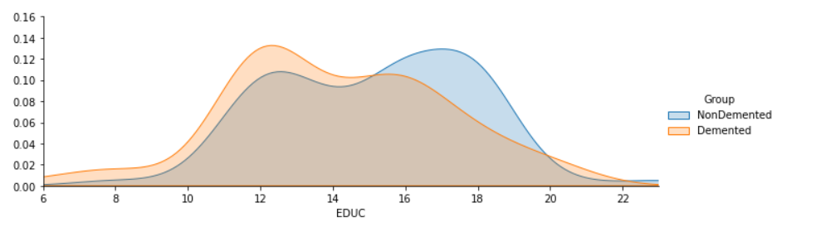
Alzheimer disease patients are less educated

Slide 22
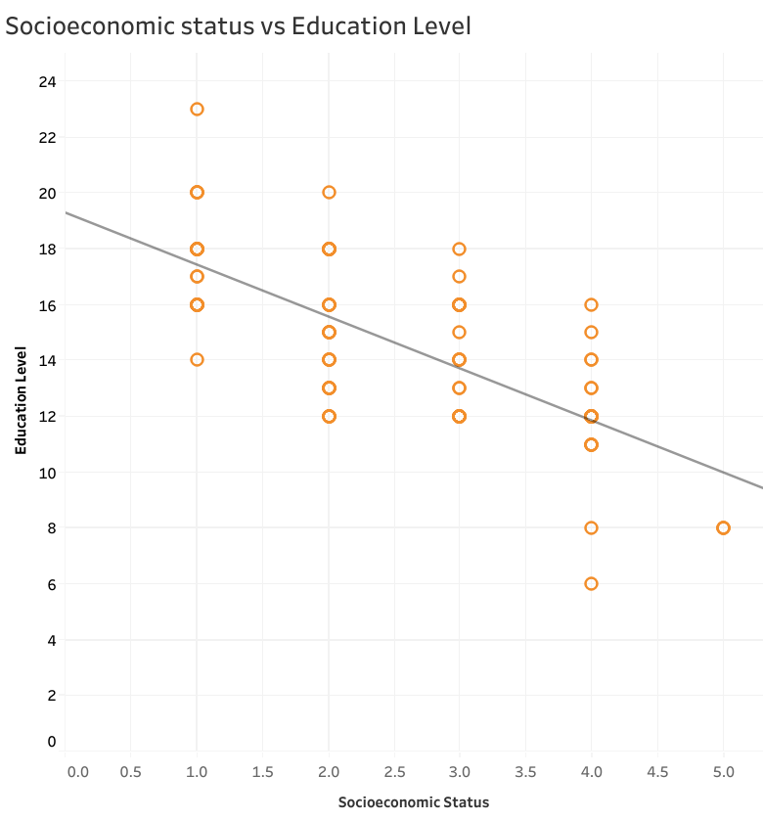
Education level had a negative trend to Socioeconomic status

Slide 23
Results of exploring
Men are more likely with demented, an Alzheimer's Disease, than Women.
Demented patients were less educated in terms of years of education.
Nondemented group has higher brain volume than Demented group.
Higher concentration of 70-80 years old in Demented group than those in the nondemented patients.
Socioeconomic status has a negative trend with education level

Slide 24
Agenda
Introduction to Alzheimer Disease
Why machine learning?
Introduction to Dataset
My approach
Models
Logistic Regression
Support Vector Machine
Random Forest
Limitations of models
Future direction

Slide 25
Main takeaways from cleaning
Socioeconomic status had no values and was also found to be correlated with Education. This column was not used for final modelling
Minus brain volume from 1st visit to 2nd visit
Used data from 2nd visit
Change converted to demented as by the 2nd visit they would be classified with Alzheimer disease

Slide 26
Predictors I’ve used
MRI metrics (2nd visit – 1st visit)
Total brain volume
Intracranial Volume
MMSE scores
Education Level
Gender
Age
Socioeconomic status used for random forest

Slide 27
Performance metrics chosen
It would be very bad is we didn’t detect patients who had Alzheimer disease and incorrectly labelled them as non-demented (False negatives)
Therefore, recall main metric
Accuracy, precision and f1 scores also used as secondary metrics

Slide 28
Definitions of performance metrics
Accuracy: How many Alzheimer disease patients out of all patients did we get right?
Precision: How many labelled Alzheimer disease patients actually have Alzheimer disease (This doesn’t matter so much)
Recall: Out of all people who have Alzheimer disease how many of those did we correctly predict (This is quite important no?)
F1 Score: harmonic mean between recall and precision

Slide 29
Agenda
Introduction to Alzheimer Disease
Why machine learning?
Introduction to Dataset
My approach
Models
Logistic Regression
Support Vector Machine
Random Forest
Limitations of models
Future direction

Slide 30
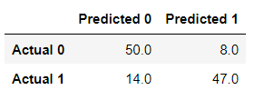
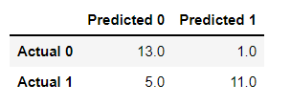
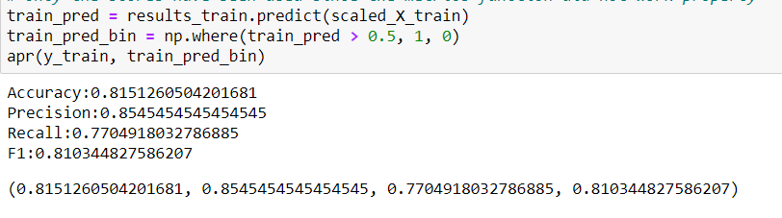
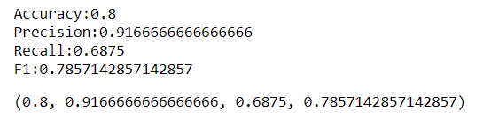
Logistic Regression
feature_cols2 = ['MMSE 2',
'EDUC',
'Age 2',
'eTIV minus',
'nWBV minus',
'Gender_M']
Test | Predicted nondemented | Predicted demented
Actually demented | 13 | 1
Actually non demented | 5 | 11
Train
Test
Test | Training | Test
Accuracy | 82% | 80%
Recall | 77% | 67%
Accuracy:: 80%
Recal: 68,75%

Slide 31
Logistic Regression
Test | Predicted nondemented | Predicted demented
Actually nondemented | 13 | 1
Actually demented | 5 | 11
Cross validation doesn’t improve the model
Performance metrics | Training | Test
Accuracy | 82% | 80%
Recall | 77% | 67%
Precision | 85% | 91%
F1 Score | 81% | 78%

Slide 32
Support Vector Machine
Conducting cross validation using GridSearch improved the model slightly
Test | Predicted nondemented | Predicted demented
Actually non demented | 14 | 1
Actually demented | 4 | 10
Performance metrics | Training | Test
Accuracy | 81% | 82%
Recall | 71% | 71%
Precision | 88% | 90%
F1 | 79% | 80%

Slide 33
Decision Tree
? Don’t know if I will have enough time to do this one im afraid

Slide 34
Random Forest
Test | Predicted nondemented | Predicted demented
Actually non demented | 13 | 3
Actually demented | 3 | 10
Conducting cross-validation using a Grid Search slightly improved the model
[[13 3] [ 3 10]]
Performance metrics | Training | Test
Accuracy | 95% | 69%
Recall | 95% | 76%
Precision | 96% | 77%
F1 | 96% | 77%
Notes:
Random forest is a supervised learning algorithm. It is versatile, easy to use machine learning that provides most of the time good results without hyperparameter testing
A random forest is a set of decision tress that are randomly generated and the expected output is chosen by the forest majority vote

Slide 35
Summing up results
Logistic Regression and Support Vector Machine performed better for accuracy
However Random Forest performed better for recall
Random Forest also saw no overfitting whereas other models did
Random Forest recommended

Slide 36
Agenda
Introduction to Alzheimer Disease
Why machine learning?
Introduction to Dataset
My approach
Models
Logistic Regression
Support Vector Machine
Random Forest
Limitations of models
Future direction

Slide 37
Limitations of my approach
Very small dataset
Research shows woman have a higher risk of Alzheimer disease than men
Healthy patients might still get Alzheimer’s in coming years
Accuracy for Random Forest was 69%

Slide 38
Agenda
Introduction to Alzheimer Disease
Why machine learning?
Introduction to Dataset
My approach
Models
Logistic Regression
Support Vector Machine
Random Forest
Limitations of models
Future direction

Slide 39
Future Directions
Bigger dataset
Conduct model on initial MRI
Dataset with longer time frames between MRI

